Slide 1


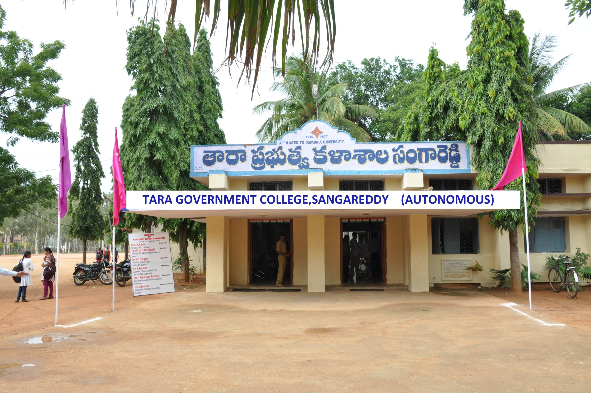
Tara Government College (A), Sangareddy Department of Data Science JIGNASA STUDENT STUDY PROJECT-2022-23 Title of the Project Breast Cancer Analysis and Prediction using Machine Learning Algorithms Submitted to Commisionerate of Collegiate Education, Hyderabad, Telangana

Slide 2

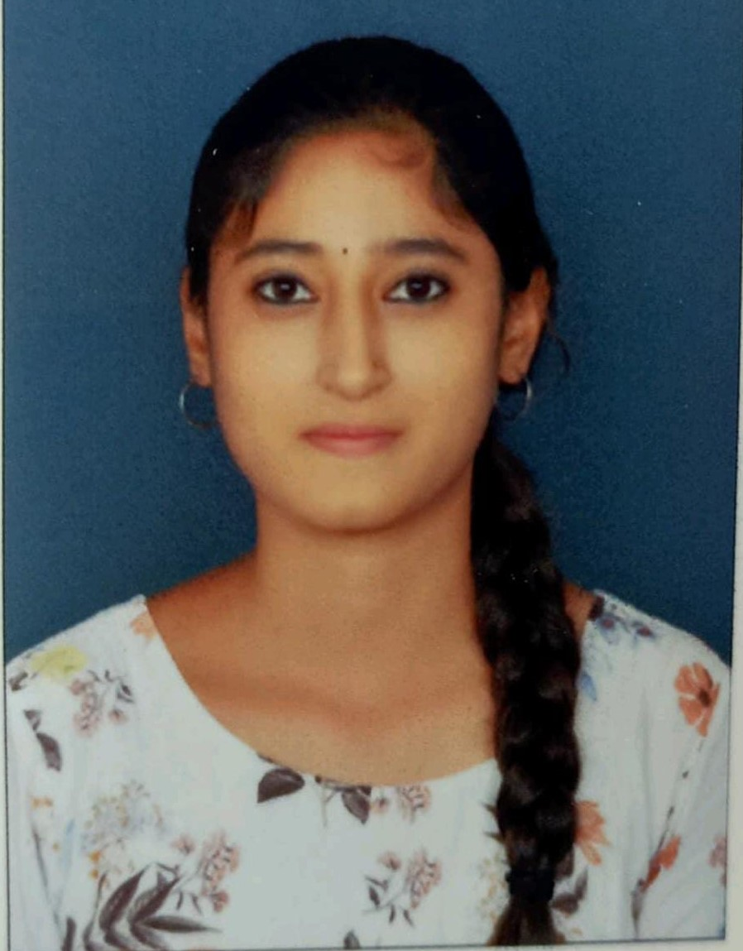





TITLE OF THE PROJECT Breast Cancer Analysis and Prediction using Machine Learning Algorithms STUDENTS PARTICIPATE
Badaganchi Dattesh Bachu Rithika Chavan Shravani Pooja patel Mohan Sai Jangam Shiva Shankar Group: BSc(MSDs)-3y Group: BSc(MSDs)-3y Group: BSc(MSDs)-3y Group: BSc(MSDs)-3y Group: BSc(MSDs)-3y Group: BSc(MSDs)-3y Roll No:605820539003 Roll No:605820539002 Roll No:605820539006 Roll No:605820539021 Roll No:605820539014 Roll No:605820539009
Supervisor of the Project: Dr. S.Nagaprasad, Faculty of Data Science Tara Government College (A), Sangareddy

Slide 3
Agenda
Introduction
Literature survey and Background
Project outcomes and Conclusions, References
Load libraries and Data exploration
Methodology
Software requirement specifications and coding & implementation

Slide 4

Abstract The leading cause of death among women is breast cancer. Medical data analysis for breast cancer prediction is complex. It was necessary for doctors and pathologists to have access to automated decision-making and tumour classification technologies. The medical profession collects a lot of data, and a machine learning (ML) algorithm helps a lot to make decisions and perform diagnosis. Some studies have shown that ML methods can aid in making decisions regarding breast cancer prediction. In this paper, we applied and compared a number of ML Classification methods—including Naive Bayes, Logistic Regression, Support Vector Machine, K-Nearest Neighbor, Decision Tree, Random Forest Classifier, Extreme Gradient Boosting, and Ensemble Methods like Variance Inflation Factor, Recursive Feature Elimination, Principal Component Analysis, and Linear SVC—to a dataset of breast cancer cases.

Slide 5
Introduction
Problem: Automated Breast Cancer Diagnosis
Context
Breast cancer is one of the most common types of cancer among women worldwide. Early and accurate diagnosis is crucial to increase the chances of effective treatment and recovery. However, manual analysis of imaging tests can be time-consuming and prone to human error. Therefore, there is a growing need to develop automated systems that can assist doctors in detecting and classifying breast lesions.
Objective
To develop a machine learning model that can automatically classify whether a breast tissue sample obtained through fine needle aspiration (FNA) is benign or malignant based on features extracted from cell nucleus images. This model will help speed up the diagnostic process and improve accuracy, providing a reliable second opinion for doctors.

Slide 6
Breast Cancer: An Overview Breast cancer (BC) is one of the most common cancers among women worldwide, representing the majority of new cancer cases and cancer-related deaths according to global statistics, making it a significant public health problem in today’s society. Some Risk Factors for Breast Cancer: The following are some of the known risk factors for breast cancer. However, most cases of breast cancer cannot be linked to a specific cause. Talk to your doctor about your specific risk. Age: The chance of getting breast cancer increases as women age. Nearly 80 percent of breast cancers are found in women over the age of 50. Personal history of breast cancer: A woman who has had breast cancer in one breast is at an increased risk of developing cancer in her other breast. Family history of breast cancer: A woman has a higher risk of breast cancer if her mother, sister or daughter had breast cancer, especially at a young age (before 40). Having other relatives with breast cancer may also raise the risk. Genetic factors: Women with certain genetic mutations, including changes to the BRCA1 and BRCA2 genes, are at higher risk of developing breast cancer during their lifetime. Other gene changes may raise breast cancer risk as well.

Slide 7
Breast Cancer Statistics: Breast cancer is the second most common cancer among women in the United States (some kinds of skin cancer are the most common). Black women die from breast cancer at a higher rate than White women. In the United States in 2019— 264,121 new breast cancers were reported in females. 42,280 females died from breast cancer. Females had much higher rates of getting breast cancer than dying from breast cancer.

Slide 8

Tumors are collections of aberrant tissue. In the case of breast cancer, tumours can be either benign (not cancerous) or malignant (cancerous). Benign: When a tumour is benign, medical professionals typically opt not to remove it. While these tumours seldom spread to healthy tissue, they sometimes continue to develop despite the fact that doing so causes discomfort. When this occurs, removal of the tumour relieves symptoms such as pain or other consequences. Malignant: Tumors that are malignant are cancerous, and they may be particularly dangerous if they infiltrate and harm the tissue around them. When a malignant tumour is suspected, a biopsy is performed to gauge the tumor's malignancy and decide treatment options.

Slide 9
Software Requirement Specification:
Software Requirement:
Operating system : Windows.
User interface : Jupyter NoteBook.
Platform : JupyterNoteBook.
Database : CSV.
Hardware Requirements:
Processor : CORE i5
Hard disk : 512 GB
RAM : 8GB
Bit : 64 bits

Slide 10







Coding and Implementation:

Slide 11
Load libraries and Data Exploration

Slide 12
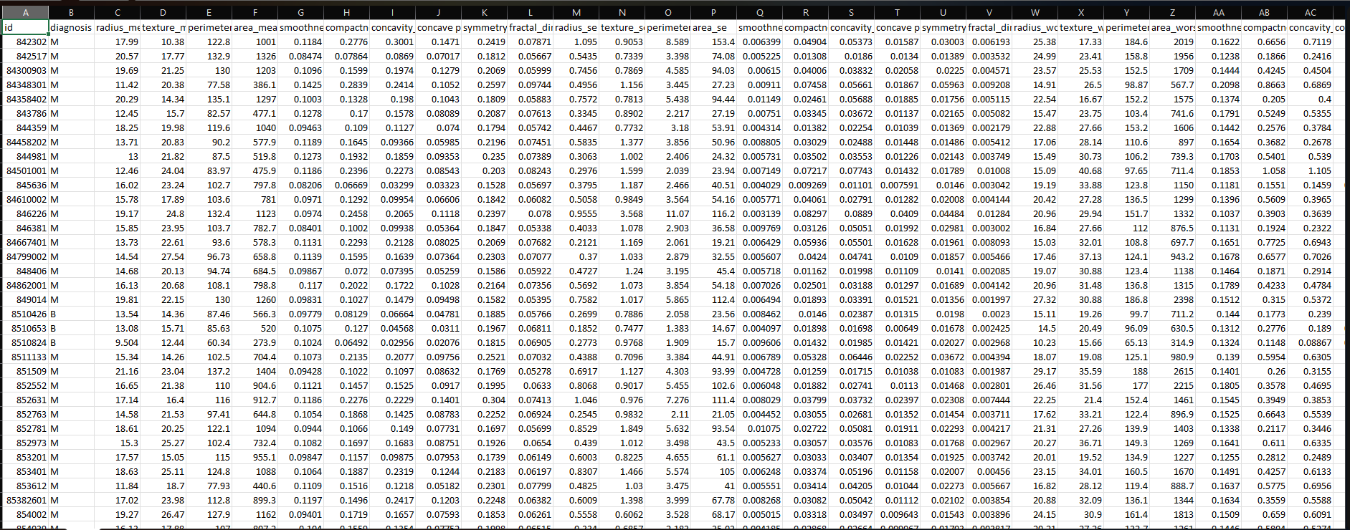
Take a View of Biopsy Data

Slide 13
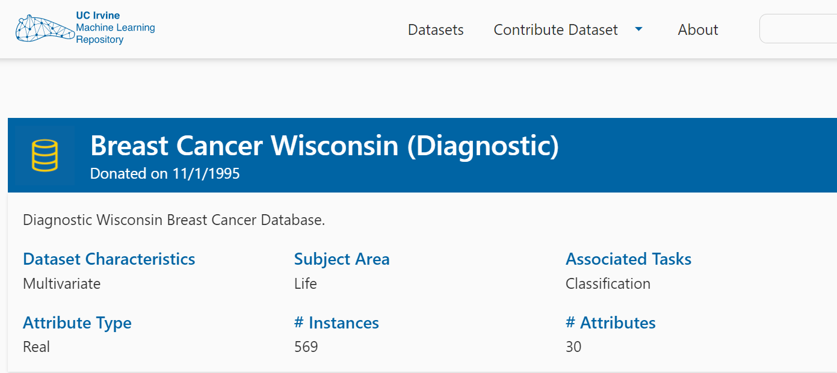
Data source
Attribute Information:
1. ID number
2. Diagnosis (M = malignant, B = benign) 3-32
Ten real-valued features are computed for each cell nucleus:
a. radius (mean of distances from center to points on the perimeter)
b. texture (standard deviation of gray-scale values)
c. perimeter
d) area
e) smoothness (local variation in radius lengths)
f. compactness (perimeter^2 / area - 1.0)
g. concavity (severity of concave portions of the contour)
h. concave points (number of concave portions of the contour)
i. symmetry
j) fractal dimension ("coastline approximation" - 1)
The mean, standard error and "worst" or largest (mean of the three largest values) of these features were computed for each image, resulting in 30 features. For instance, field 3 is Mean Radius, field 13 is Radius SE, field 23 is Worst Radius.
All feature values are recoded with four significant digits. Missing attribute values: none Class distribution: 357 benign, 212 malignant
We have used publicly available dataset Breast Cancer Wisconsin and have download from UCI Machine Learning Repository. Repository:
https://archive.ics.uci.edu/ml/datasets/Breast+Cancer+Wisconsin+%28Diagnostic%29

Slide 14
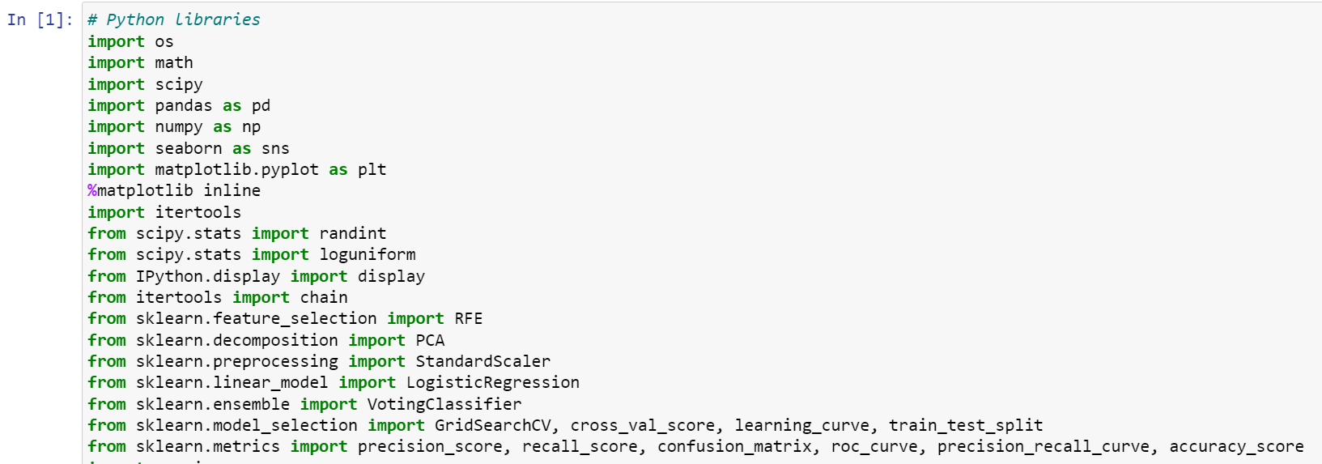
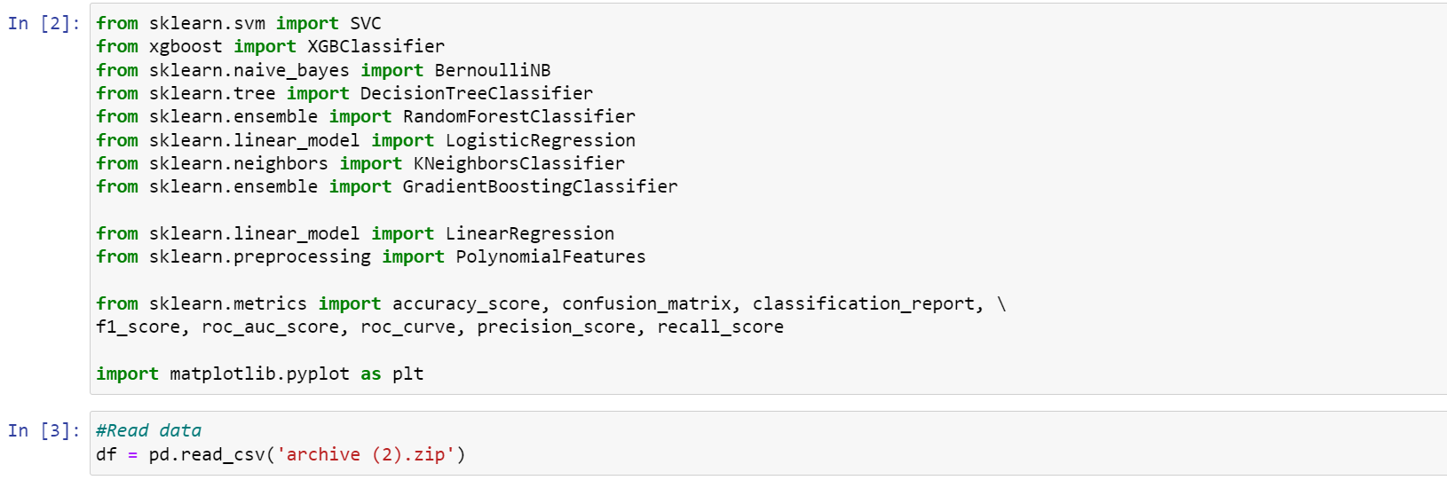
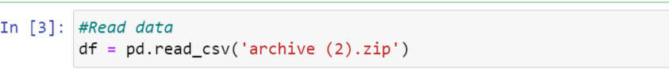
Load libraries
Read the Data

Slide 15
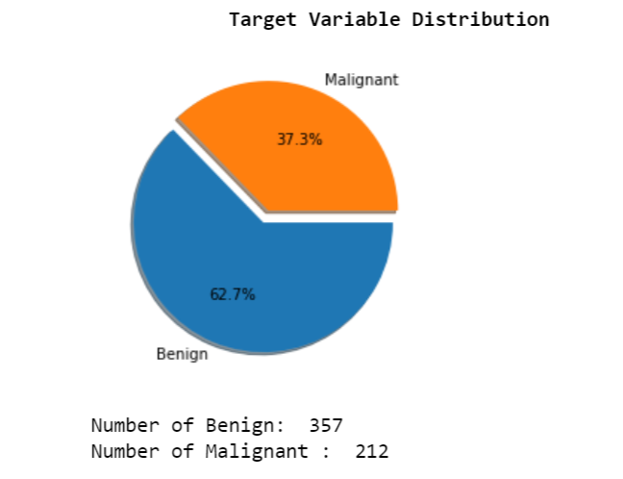
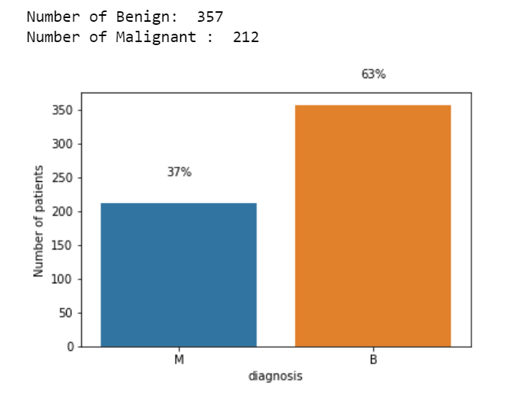
Exploring and Preparing the Data
Exploratory data analysis (EDA) is used by data scientists to analyze and investigate data sets and summarize their main characteristics, often employing data visualization methods. It helps determine how best to manipulate data sources to get the answers you need, making it easier for data scientists to discover patterns, spot anomalies, test a hypothesis, or check assumptions.

Slide 16
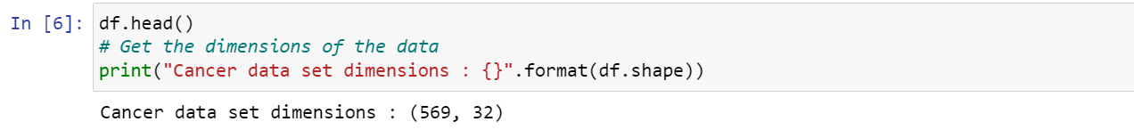
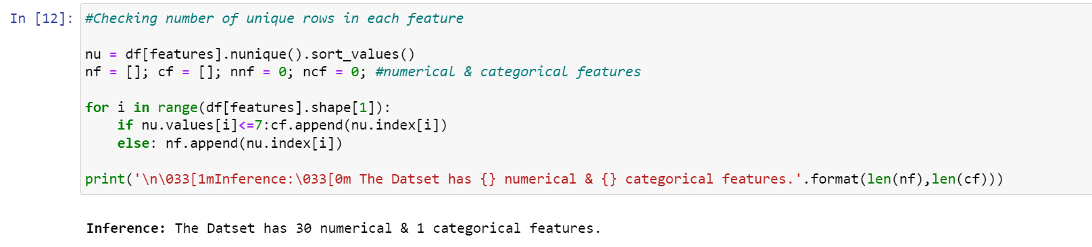
Cleaning the Data
The majority of a data scientist's time is spent cleaning and reducing datasets to a manageable size and format. It is my opinion that up to 70% of your overall project time will be devoted to data investigation, cleansing, and preparation. Duplicated rows and empty columns are two of the most common types of errors in a dataset, but there are many others. The issue of data quality is high on the list of concerns for data administrators. as skewed analytics and poor judgment stemming from filthy data are commonplace.

Slide 17
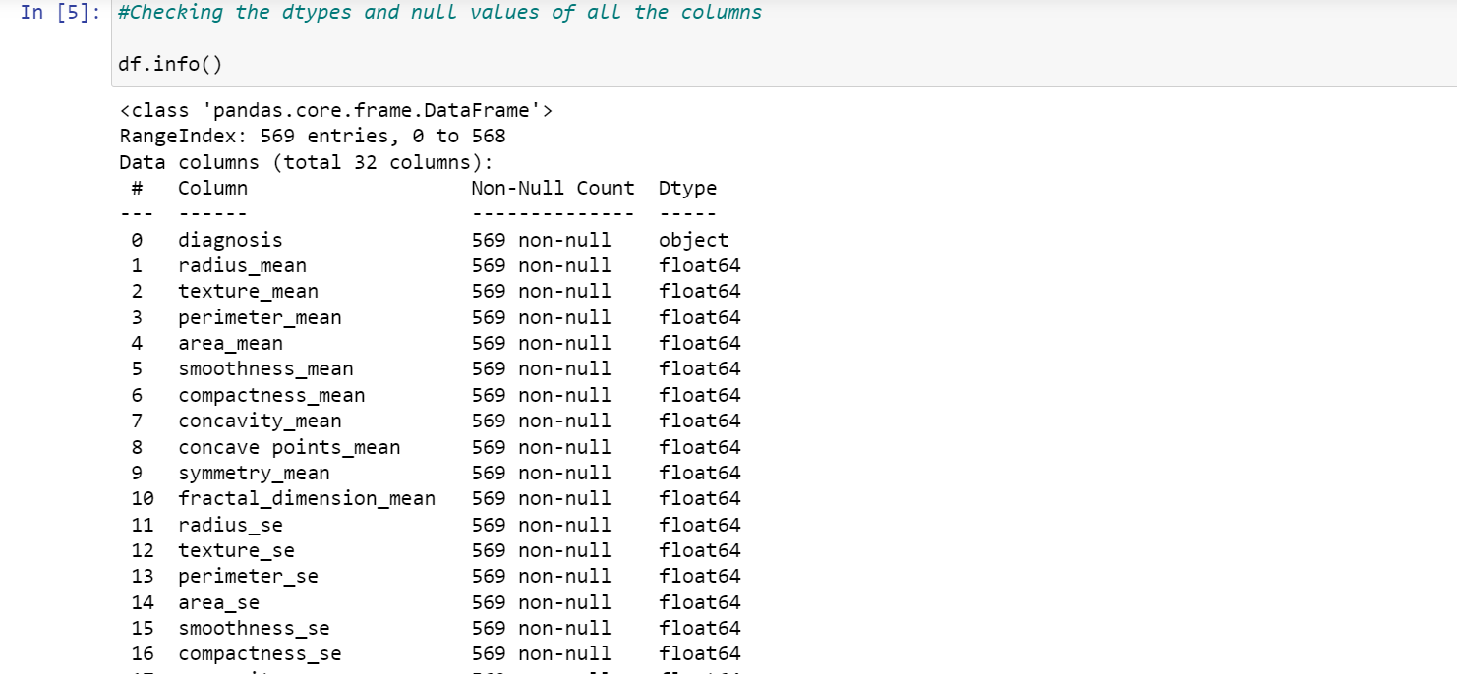
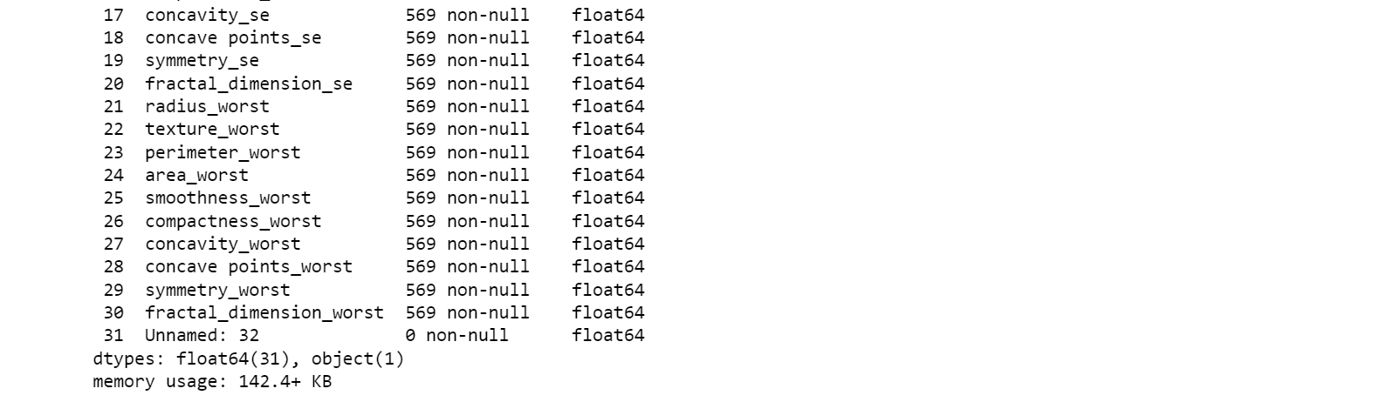
Check missing or Null data points
There is an id that cannot be used for classification
Diagnosis is our class label
Unnamed: 32 feature includes NaN so we do not need it.

Slide 18
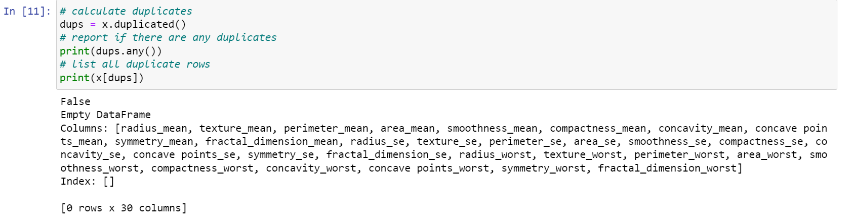
Check and identify rows that contain duplicate records
Each row of the data represents an observation for one patient and the columns hold the variables. There are total 569 patients with 32 columns. There are 30 numerical columns, ID column and 1 categorical class column. There are no missing and duplicate values in the dataset.

Slide 19
Methodology

Slide 20
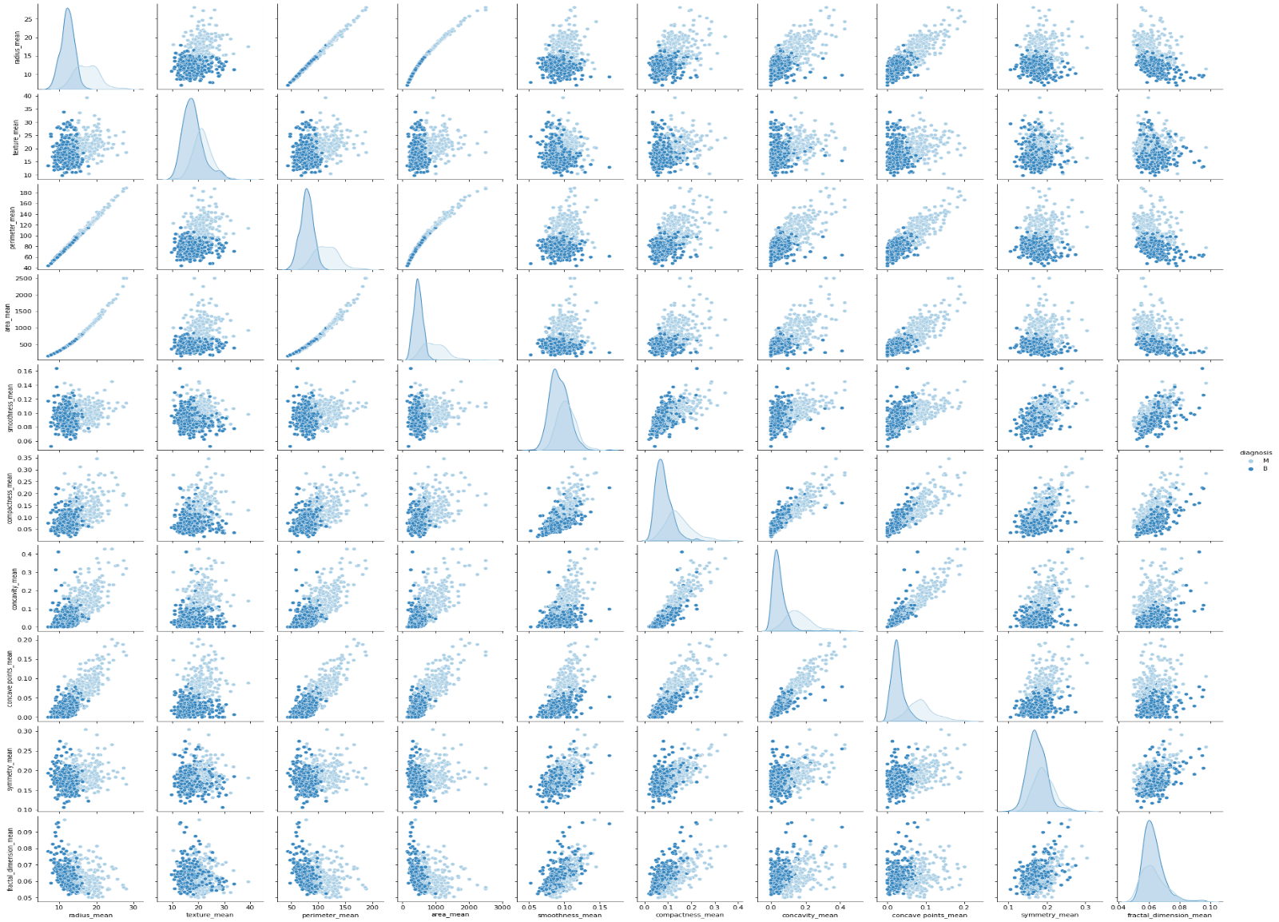
Exploring data using pair plots:
I plot features in 3 group and each group includes 10 features to observe better.
This are pair plot for mean column
1

Slide 21
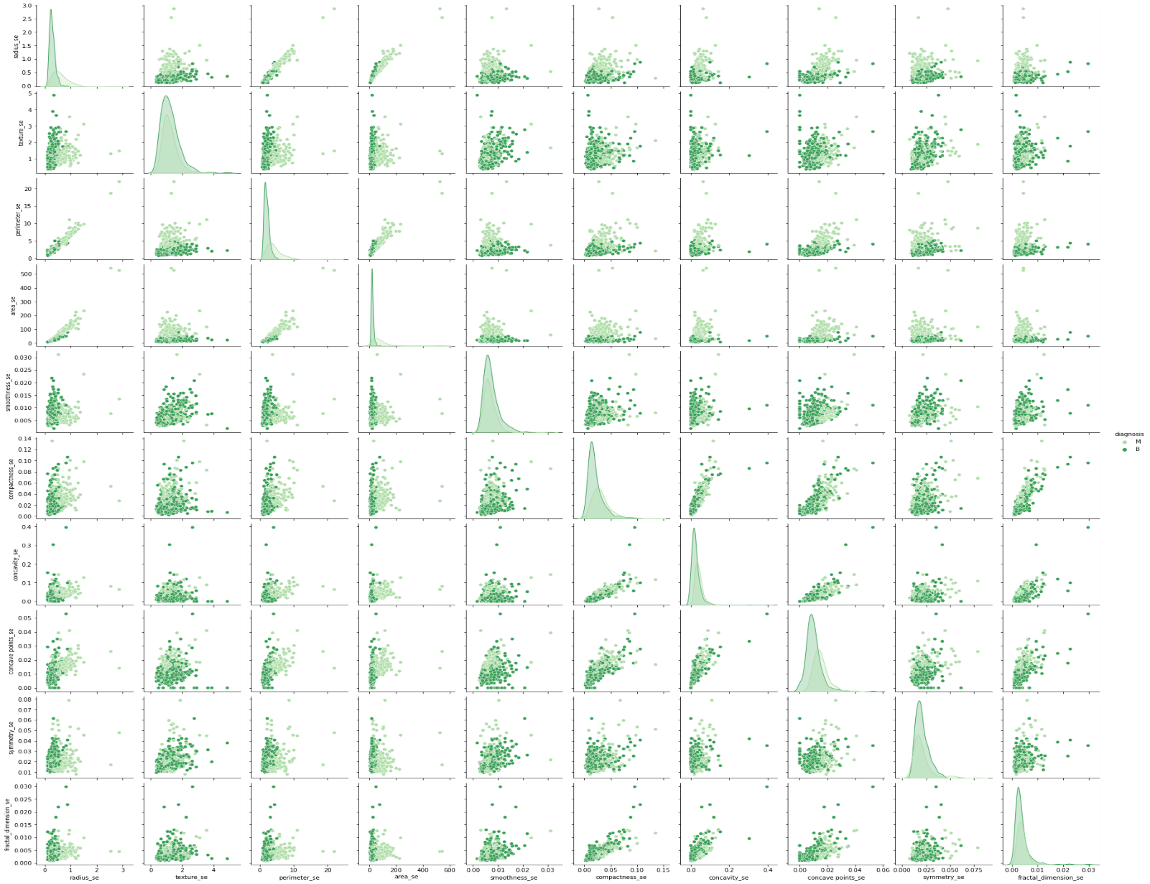
2
This are pair plot for SE columns

Slide 22
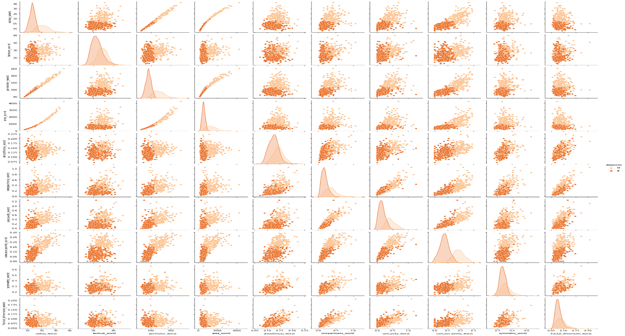
3
This are pair plot for worst columns

Slide 23
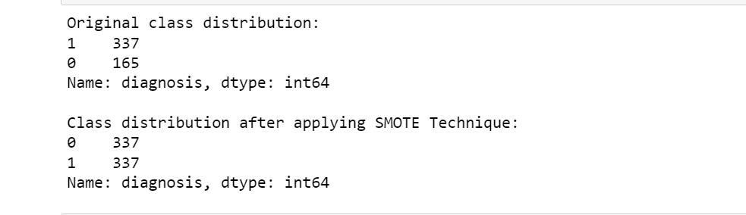
Data preprocessing:
Fixing imbalance using SMOTE technique.
SMOTE:
SMOTE is a machine learning technique that solves problems that occur when using an imbalanced data set. Imbalanced data sets often occur in practice, and it is crucial to master the tools needed to work with this type of data.
SMOTE stands for Synthetic Minority Oversampling Technique. The method was proposed in a 2002 paper in the Journal of Artificial Intelligence Research. SMOTE is an improved method of dealing with imbalanced data in classification problems.

Slide 24
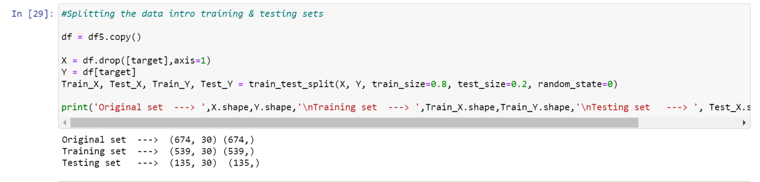
Data Manipulation
In this project, the cohort of 569 patients is randomly divided into two parts: two-third (70%)(training set) for developing a prediction model and the remaining one-third (30%) for validating the developed model (test set)
Feature scaling:
Feature scaling is a method to standardize the features present in the data in a fixed range. It has to perform during the data pre-processing. It has two main ways Standardization and Normalization.
In this project doing two types standardizations.
One is the training standardization, Second is the test standardization
.

Slide 25
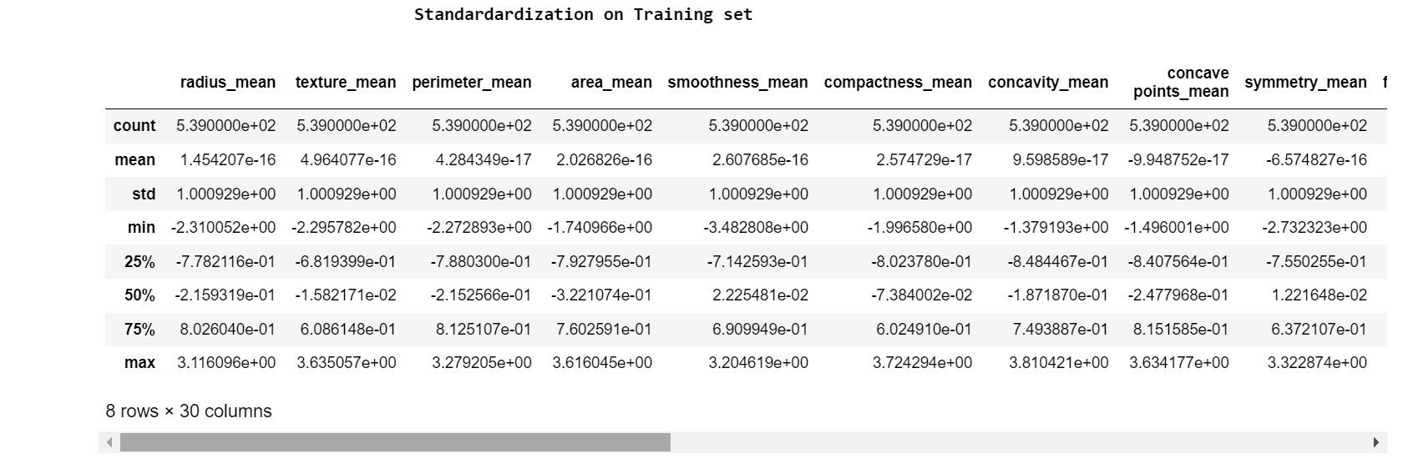
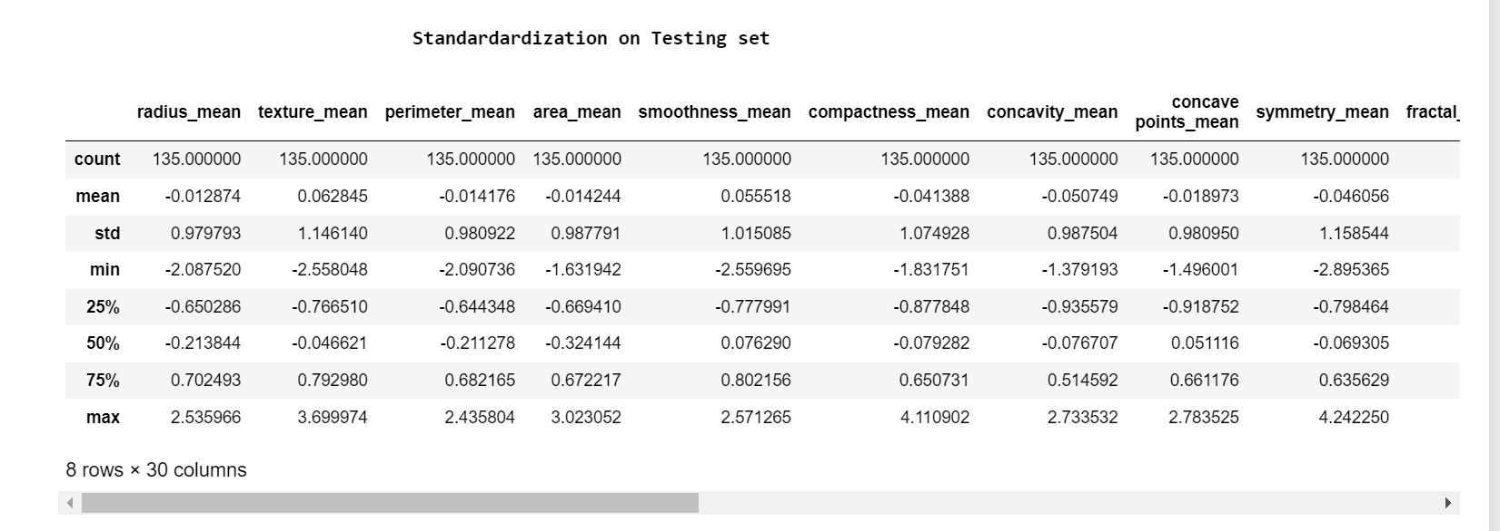

Slide 26
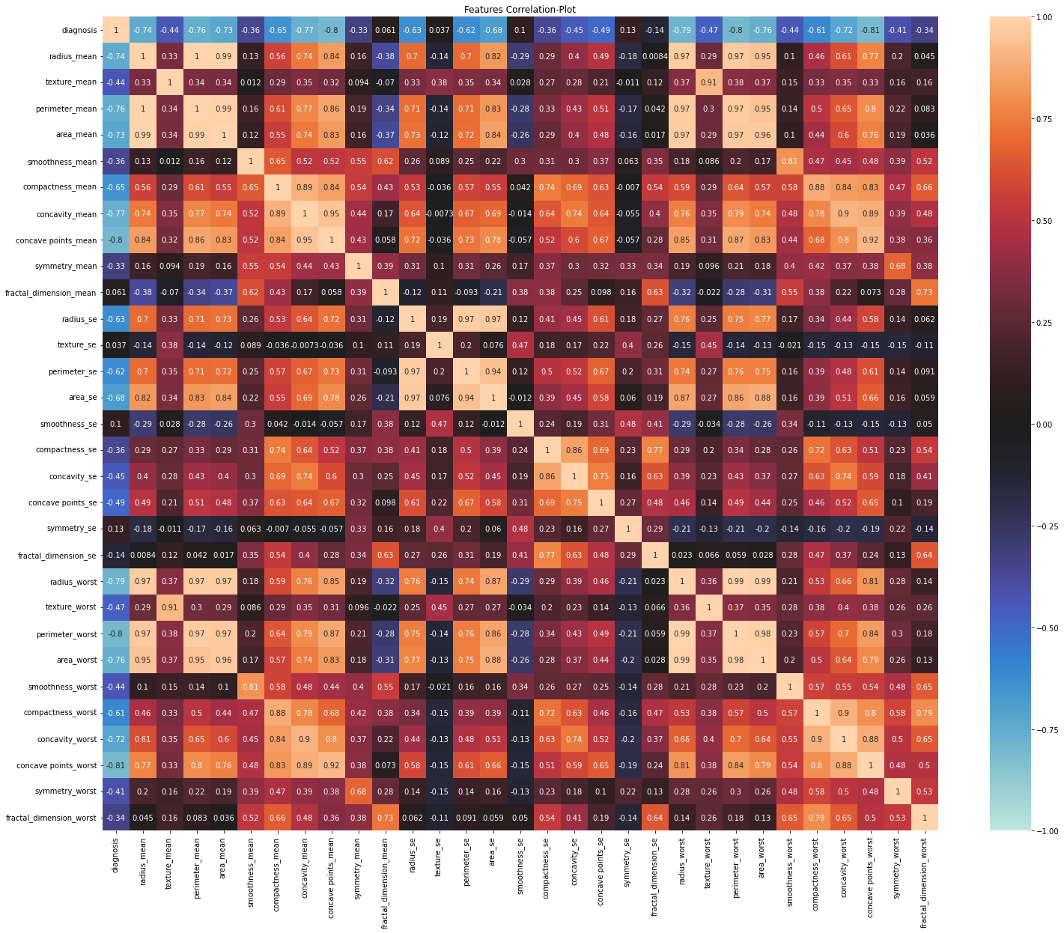
Feature selecting/Extraction:
Correlation:
Features correlation plot

Slide 27
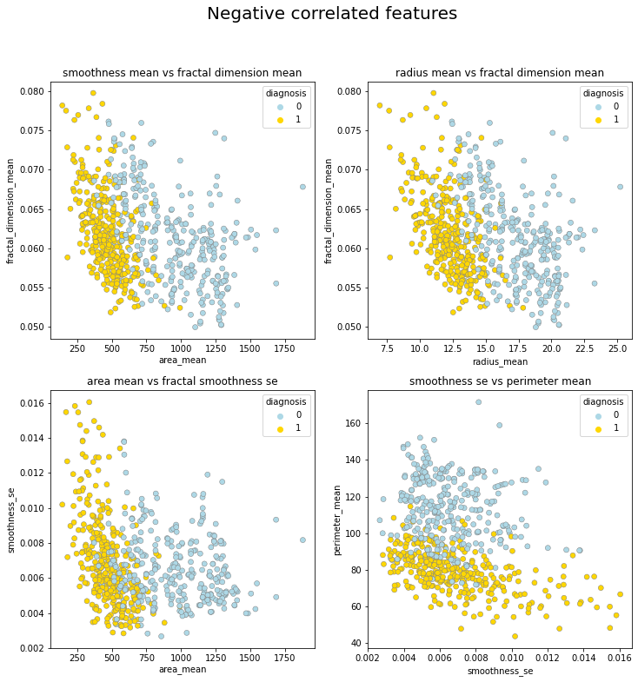
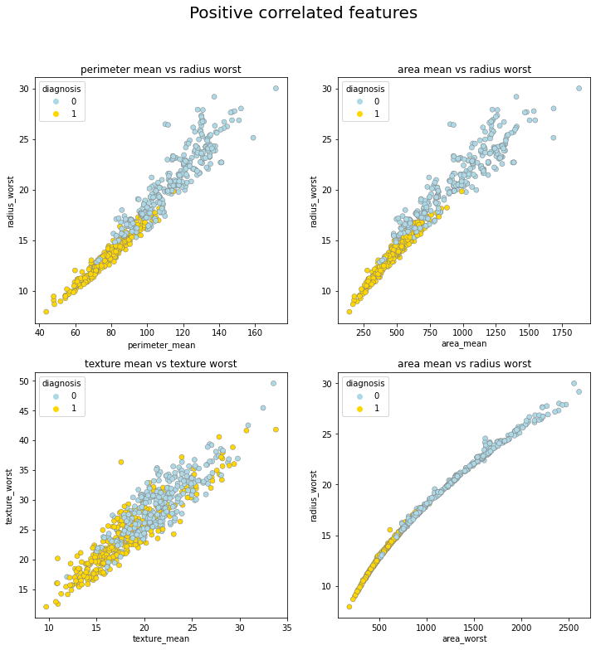
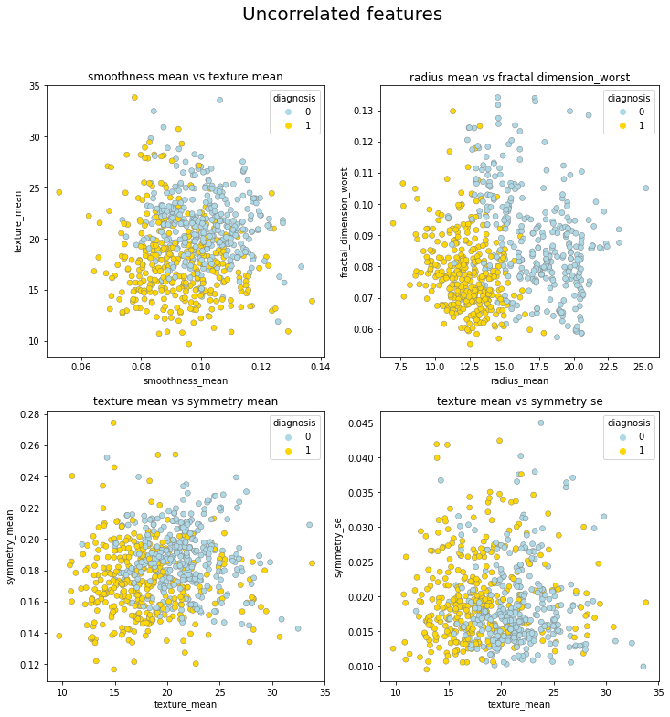

Slide 28
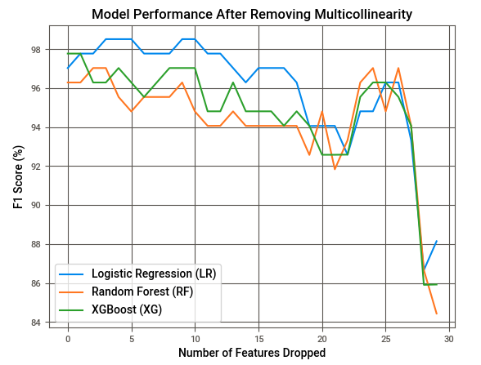
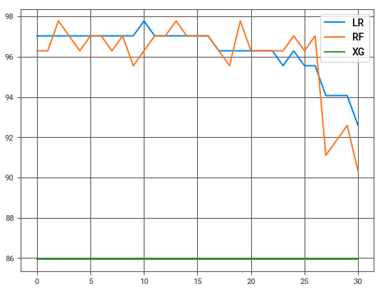
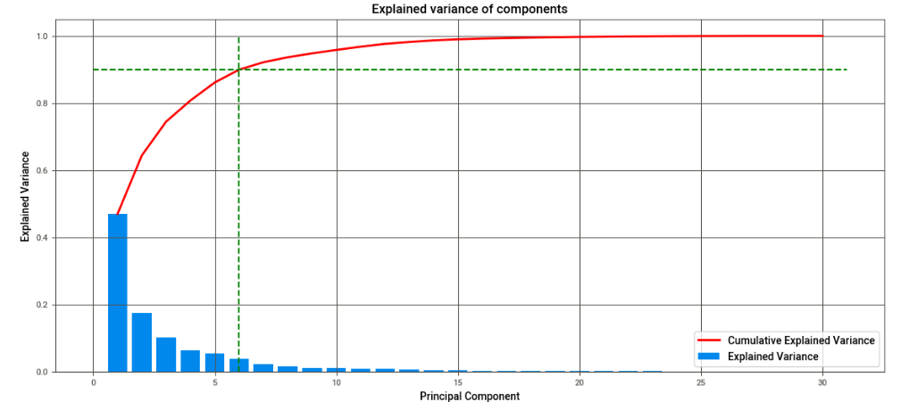
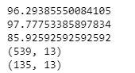
We can fix these multicollinearity with 3 techniques:
Manual Method - Variance Inflation Factor (VIF)
Automatic Method - Recursive Feature Elimination (RFE)
Decomposition Method - Principle Component Analysis (PCA)
1
2
3

Slide 29
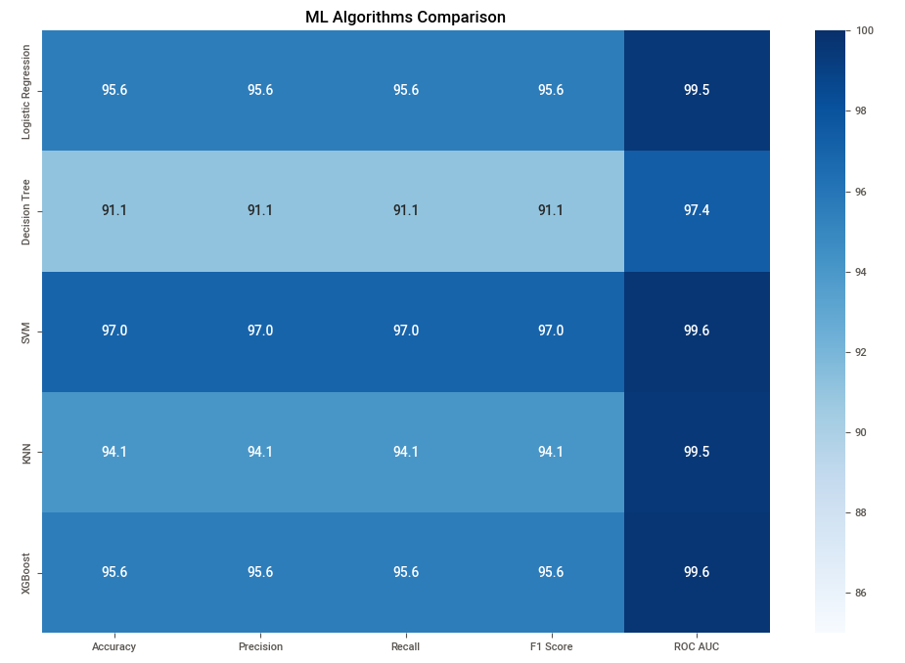
Model performance plot( Accuracy, Precision, Recall, F-score)
ML algorithms comparisons:

Slide 30
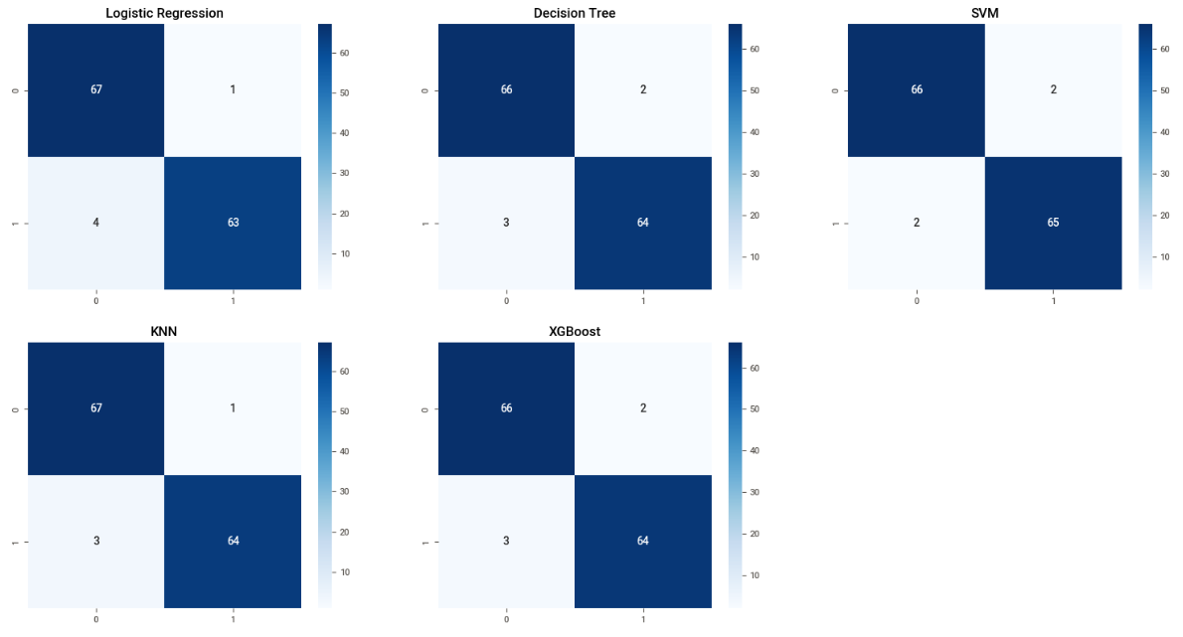
Data modeling and Validation:
Confusion-matrix : The confusion matrix is a matrix used to determine the performance of the classification models for a given set of test data. It can only be determined if the true values for test data are known. The matrix itself can be easily understood, but the related terminologies may be confusing.

Slide 31
Project Outcomes and Conclusions
The Dataset was quiet small totalling around 569 samples & after preprocessing 7.3% of the data samples were dropped.
The samples were slightly imbalanced after processing, hence SMOTE Technique was applied on the data to balance the classes, adding 18.8% more samples to the dataset.
Our objective will be to train our models to predict if a tumor is benign or malignant, based on the features selected.
Out of the 569 patients in the dataset, the class distribution is: Benign: 357 (63%) and Malignant: 212 (37%)
The SVM, Random Forest Classifier & XG-Boosting performed exceptionally well on the current dataset, considering Recall Score as the key-metric.
Yet it wise to also consider simpler model like Logistic Regression as it is more generalisable & is computationally less expensive, but comes at the cost of slight misclassifications
The first column is an ID that identifies each patient.
Diagnosis is a categorical variable.
Missing attribute values: none
There is high variation in values in area_mean and area_worst.
There are many variables have median value 0.

Slide 32
REFERENCE:
Scikit-learn user guide. https://scikitlearn.org/stable//downloads/scikit-learn-docs.pdf.
Hands on Machine learning with Scikit-learn, Keras and Tensor Flow. Aurelien Geron
Kaggle website. Kaggle(https://www.kaggle.com/datasets)
W.H. Wolberg, W.N. Street, and O.L. Mangasarian. Machine learning techniques to diagnose breast cancer from fine-needle aspirates.
Breast Cancer Wisconsin and have download from UCI Machine Learning Repository: https://archive.ics.uci.edu/ml/datasets/Breast+Cancer+Wisconsin+%28Diagnostic%29
Introduction to Machine Learning with Python: A Guide for Data Scientists, Andreas C. Miiller and Sarah Guido.

Slide 33


